Slide 1
Developments in and challenges for industrial relations in Europe
Prof. Maarten Keune
Pescara, 25 September 2015

Slide 2
Structure
The role of the EU
Core industrial relations issues
Challenges to industrial relations
2

Slide 3
EU-EMU and industrial relations
Changing position EU: decentralisation CB, lower minimum wages, wage moderation public sector, less influence unions
Reflected in country-specific recommendations
Troika: imposed change
EMU: adaptation through wages, flexibility
Free movement, posted workers
Weakness EU social dialogue and coordination
3

Slide 4
Unions and employers’ organisations
Steady decline union density in almost all EU countries, including Nordics
Very low levels of unions density may lead to substantial weakening unions and institutions when membership is key for influence (e.g. NL)
Employer membership more stable and generally higher than unions. Decline in DE
4

Slide 5
Decentralisation bargaining?
Decentralisation long term trend in EU, recently accelerated under EU-Troika pressure
Mixed developments wages bargaining centre-nord
DE: decentralisation through opening clauses, defection employers (disorganised) e copertura ridotta
DK decentralisation with low coordination (sector minimum)
SE decentralisation with high coordination (sector back-up)
NL continuity at sector level
FI, BE (re-) centralisation
More general decentralisation non-wage issues, CA as frameworks
5

Slide 6
Coverage
Dramatic declines in Troika or IMF countries (PT, ES, GR, RO …)
Steady decline in Germany
High (>80%) and relatively stable in NL, BE, AT, SE, DK, FR
Public sector: austerity leads to unilateralism
6

Slide 7
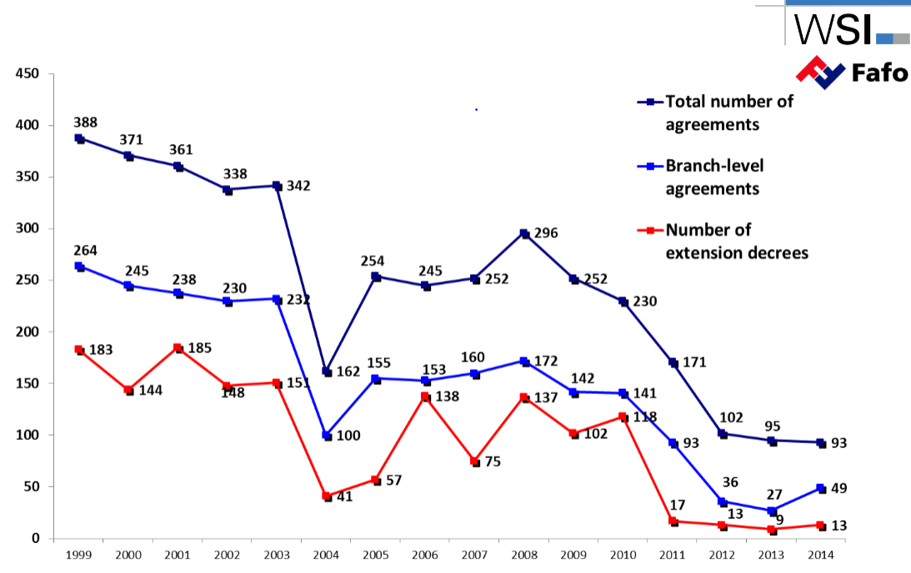
Collective agreements: Portugal
7

Slide 8
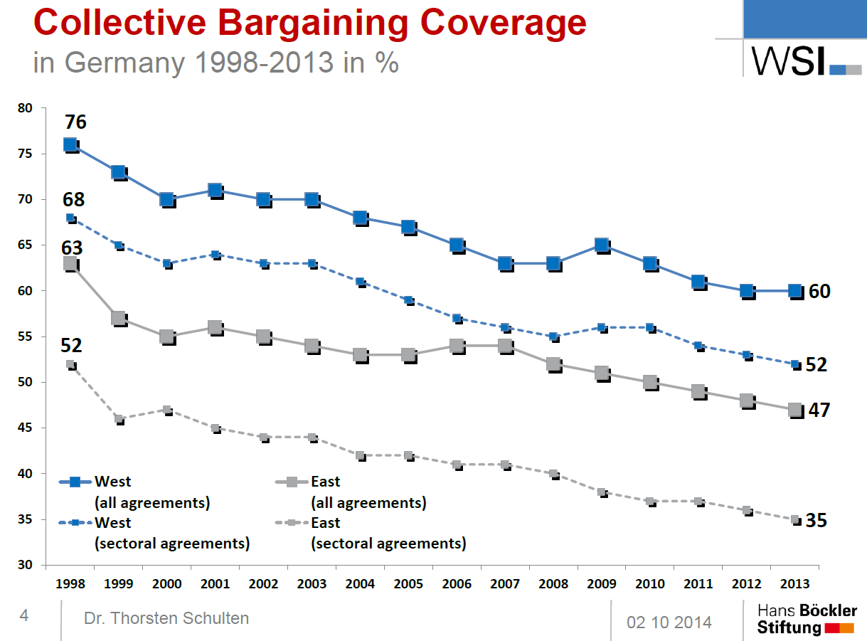
8

Slide 9
Wage moderation
Longer-term development, competitive strategy
Dutch since ‘82, no real increase in CA wages
Further strengthened by crisis and austerity
Steadily declining wage share
Difference between multi-employer and single-employer bargaining systems
Reflects ideology and increasing power employers over workers
9

Slide 10
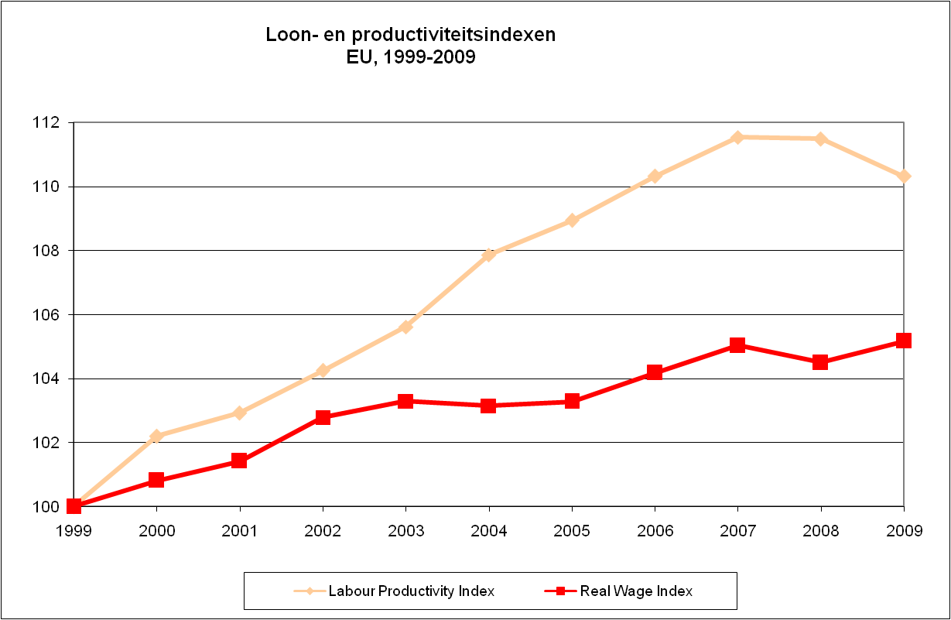
Lonen en productiviteit, EU
10

Slide 11
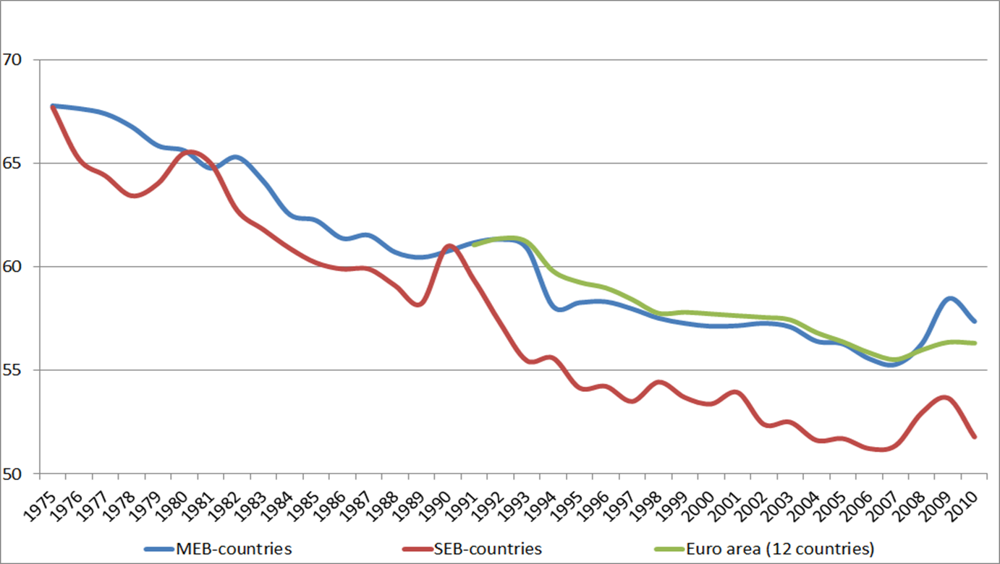
Wage share in MEB and SEB countries and the euro-zone, 1975-2010
11

Slide 12
Major challenges to industrial relations
Inequality, precarious work and dualisation
Third parties
Self-employed
Union membership
Change of discourse
12

Slide 13
Inequality and precariousness
Growth inequality and precarious jobs: low pay, flexible jobs, jobs outside protection law, …
Accumulation disadvantages (DE)
Damaging to society and economy (Piketty, Wilkinsons and Picket, IMF, ILO, OECD)
Major challenge governments and collective labour relations
Taken up to some extent. But insufficient to curb trend
13

Slide 14
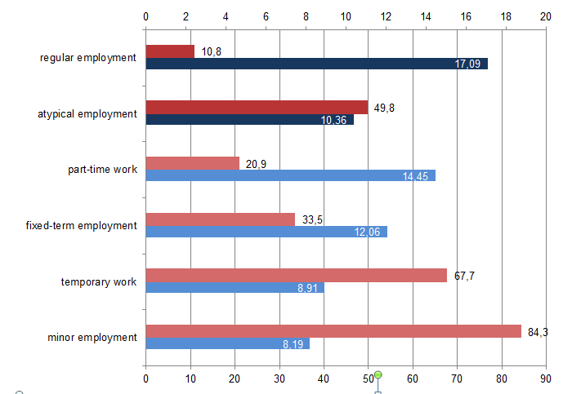
Germany: % low wage (below 2/3 mean) and average wage per type of job
14

Slide 15
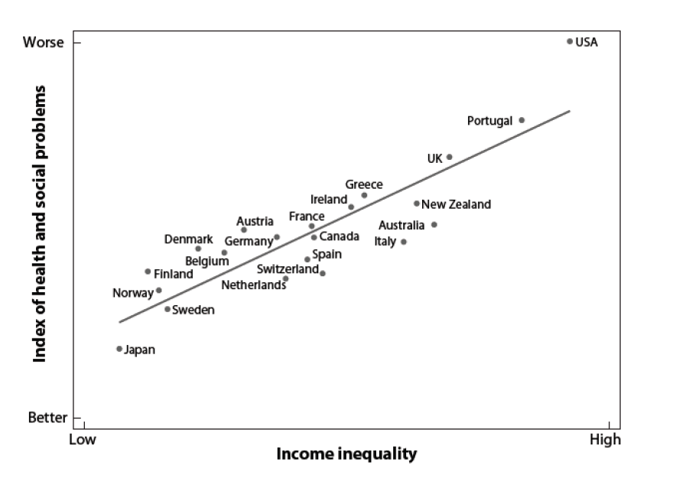
Inequality and social and health problems
15

Slide 16
The role of third parties
Growing influence of third parties
Those who tender projects, including public procurement (e.g. construction)
Clients of temporary work agencies or cleaning companies
Outsourcing
Are not employer but exert strong pressure for cost reduction and flexibility, destructive competition, leading to increasing precariousness.
Increasingly focus of industrial conflict
16

Slide 17
Self-employment
Growing group of vulnerable self-employed, often involuntary, with low income and low social protection
Blurring of the boundaries between self-employment and waged employment: dependent self-employment
Challenge to include them in interest representation (but employers or unions?), collective agreements and social security
17

Slide 18
Strengthening worker representation
Decline union density undermines entire industrial relations system
Continued demand for collective representation
Does membership reflect support and legitimacy?
Strengthening membership → how?
Or new bases for union legitimacy and power, e.g. greater role elections; or new actors?
18

Slide 19
Change of discourse
“Battle of ideas”: dominance ≠ superiority
Dominant discourse based on market efficiency, capital mobility, autonomy financial markets and individual responsibility situation
Leads to weakening industrial relations, more precarious work and increasing inequality
More debate, repolitization of economic and social policy, what is a good labour market and what role collective actors. Alternative ideas and how to break the present status quo
19

